Slide 1
Pioneering Event Technology

Slide 2
Complete Event Lifecycle for Delegates

Slide 3
Delegate - Event Lifecycle
Awareness
At the Event
Registration
On the Move
Visit Planning
Arrange Meetings
Pre-Event Networking

Slide 4
Techworld – Home Awareness

Slide 5
Registration – UK Delegate Registration

Slide 6
Registration – UK Delegate Details Registration

Slide 7
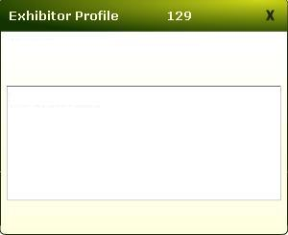
Visitor View Visit Planning
Coconnex
Coconnex is the official supplier of TechWorld
2011 event software and will exhibiting on
stand 128. Coconnex is a pioneering online
service (SaaS) representing the evolution of
event technology. Incorporating a fully
integrated set of modules designed to provide
a comprehensive range of features allowing

Slide 8
Delegate – Conference Summary Visit Planning

Slide 9
Delegate – Conference By Date Visit Planning

Slide 10
Delegate – Landing Page Pre-Event Networking

Slide 11
Delegate – All Attendees Pre-Event Networking

Slide 12
Delegate – My Favorites Pre-Event Networking

Slide 13
Delegate – Appointment Set-Up Arrange Meetings

Slide 14
Delegate – Appointments Arrange Meetings

Slide 15
Delegate – Search Arrange Meetings

Slide 16
Delegate – Search Result Arrange Meetings

Slide 17
Delegate – My Schedule Arrange Meetings

Slide 18
Delegate – Upgrade Package

Slide 19
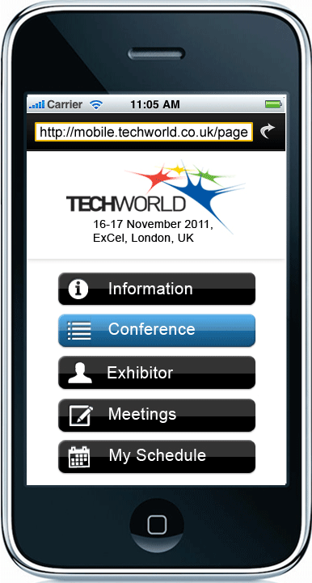
Mobile -Home Page On the Move

Slide 20
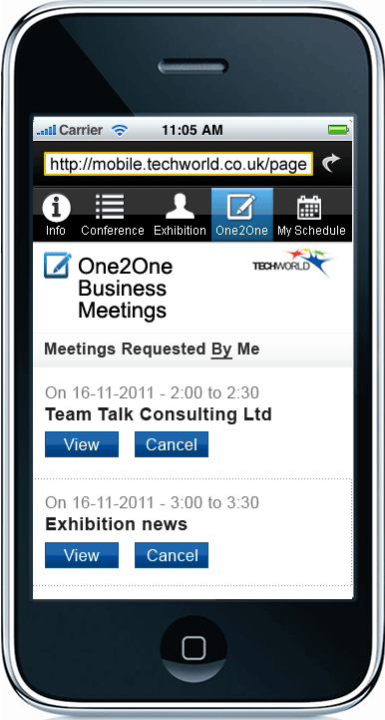
Mobile – On2One On the Move On the Move

Slide 21
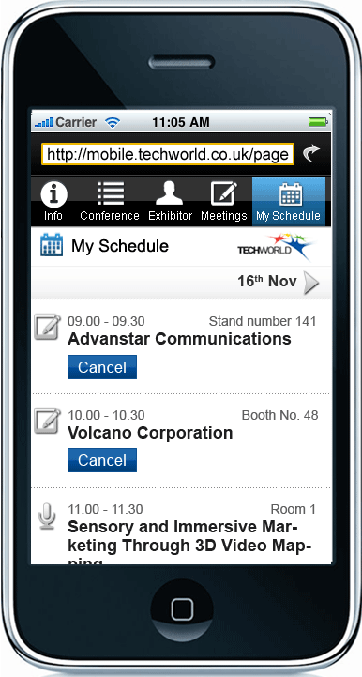
Mobile – Appointments On the Move

Slide 22
Giant iTab & Mobile – Home At the Event

