Slide 1
Pioneering Event Technology

Slide 2
Event Organiser Features

Slide 3
Coconnex Exhibition Technologies
Organiser Control
Exhibitor Management
Exhibitor Registration
Interactive Floor Plan

Slide 4
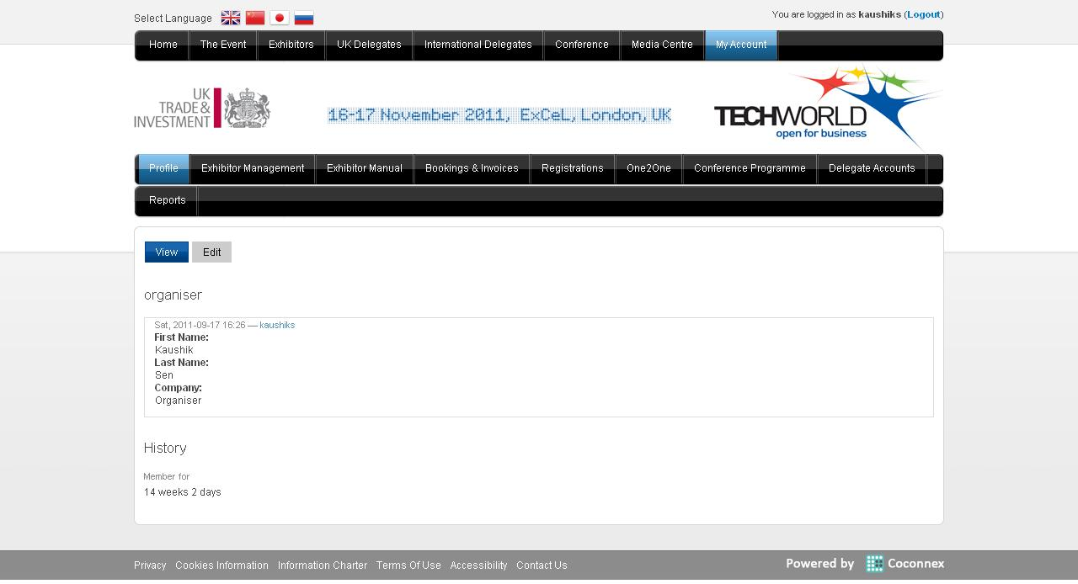
Organiser – Landing Page

Slide 5
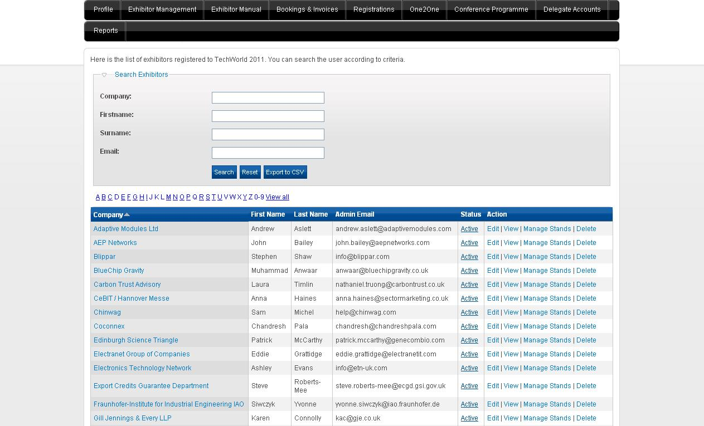
Organiser – Exhibitor List

Slide 6
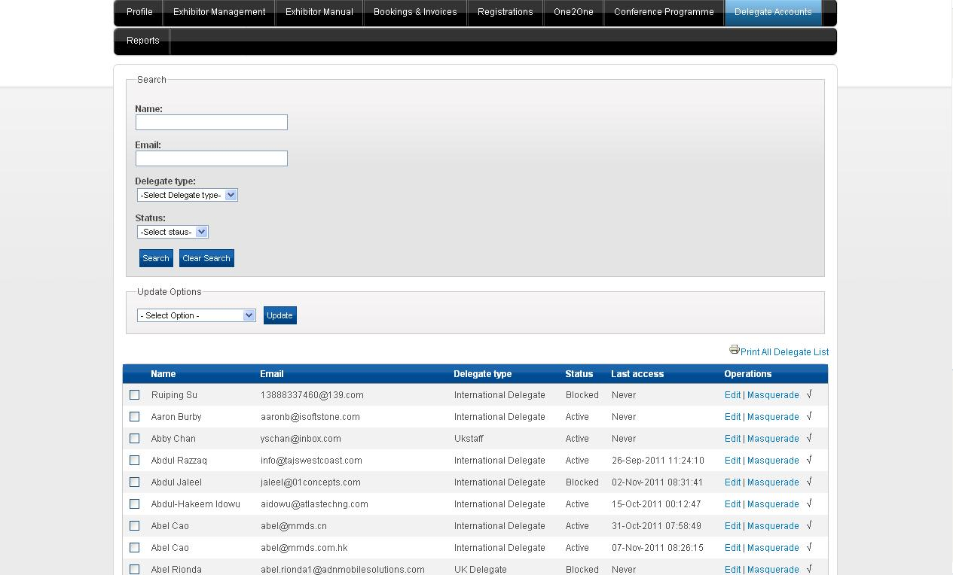
Organiser – Delegate List

Slide 7
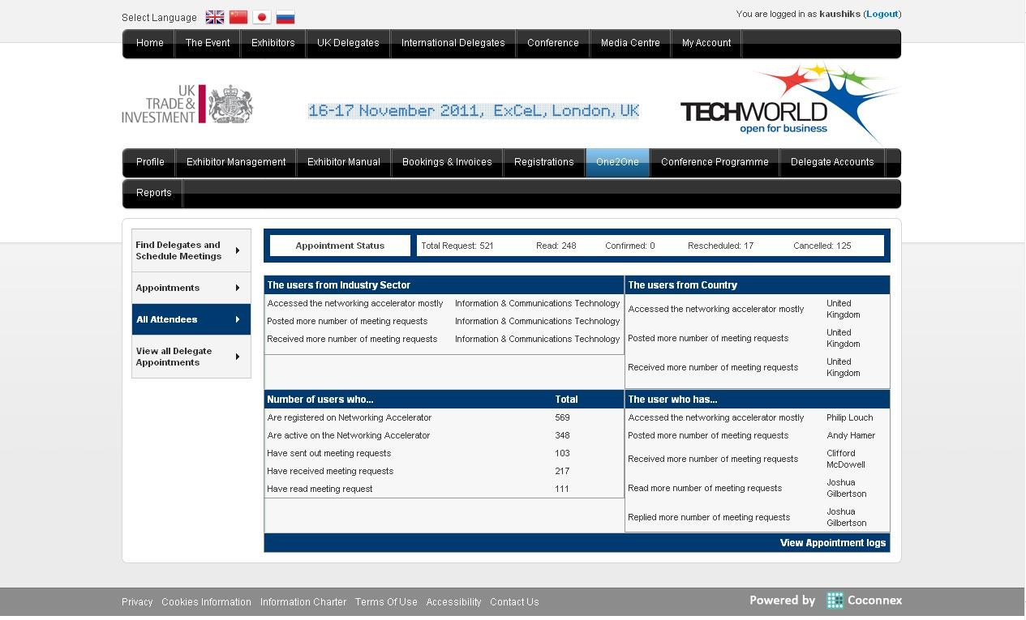
Organiser – All Attendees Status

Slide 8
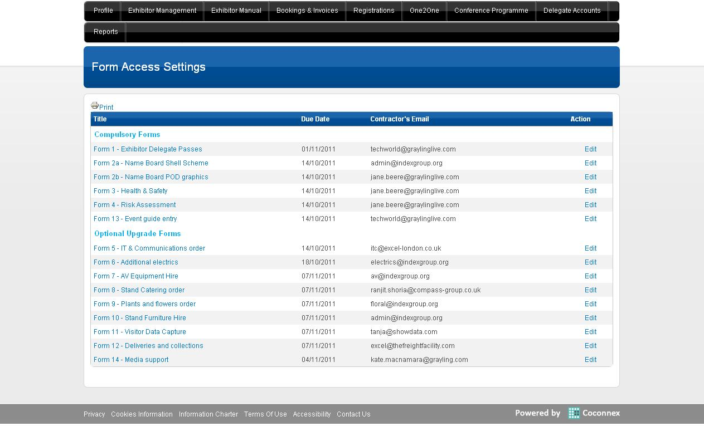
Organiser – Exhibitor Manual Manage Forms

Slide 9
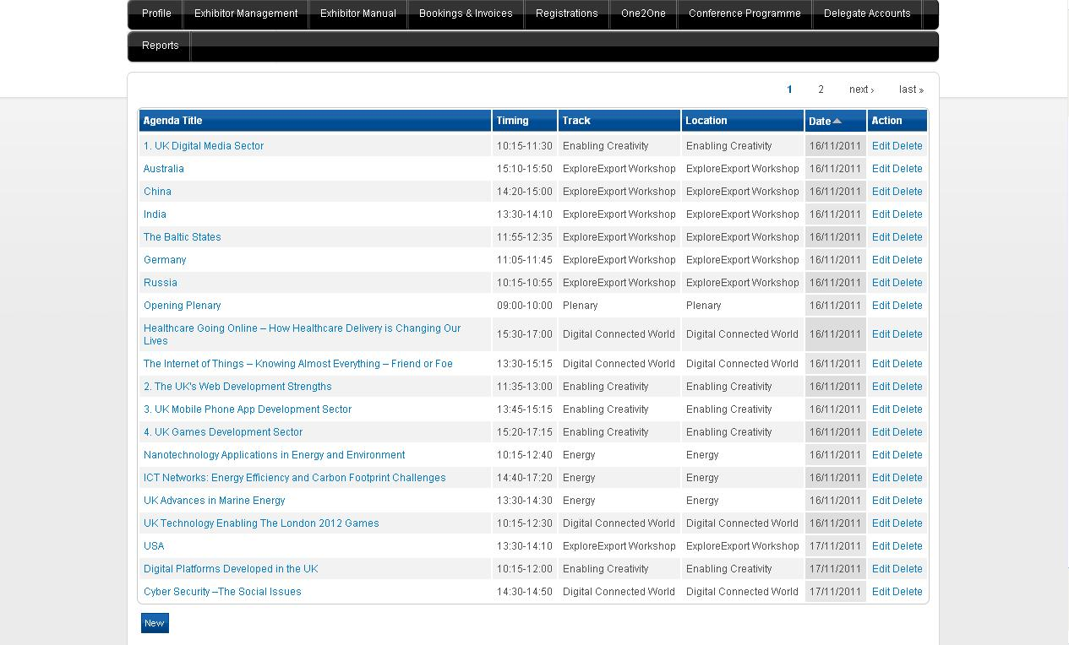
Organiser – Manage Seminars

Slide 10
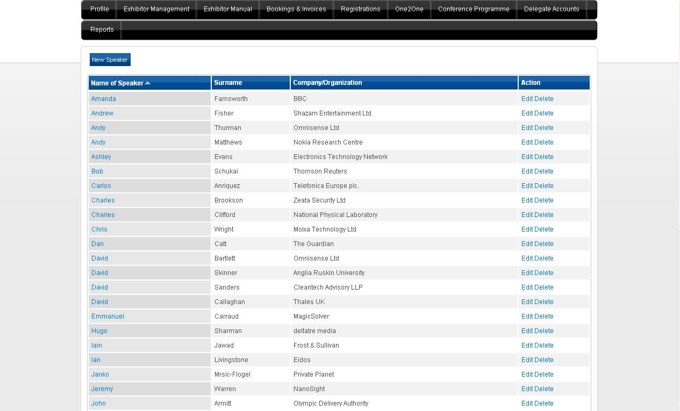
Organiser – Manage Speaker

Slide 11
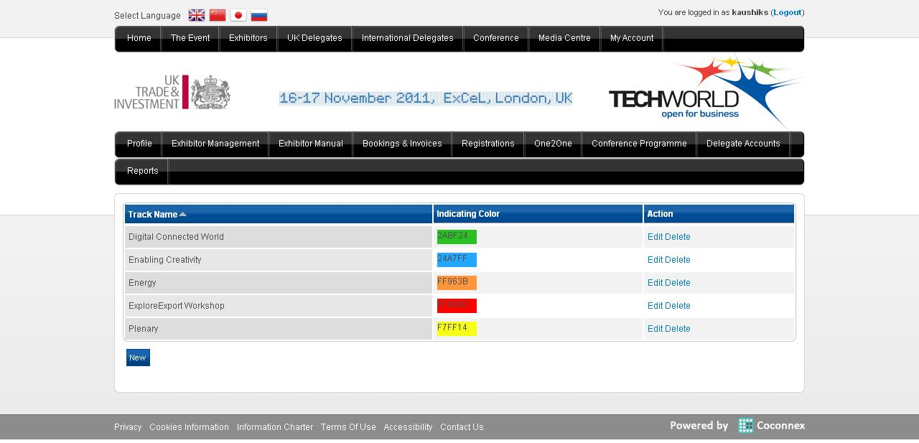
Organiser – Manage Track

Slide 12
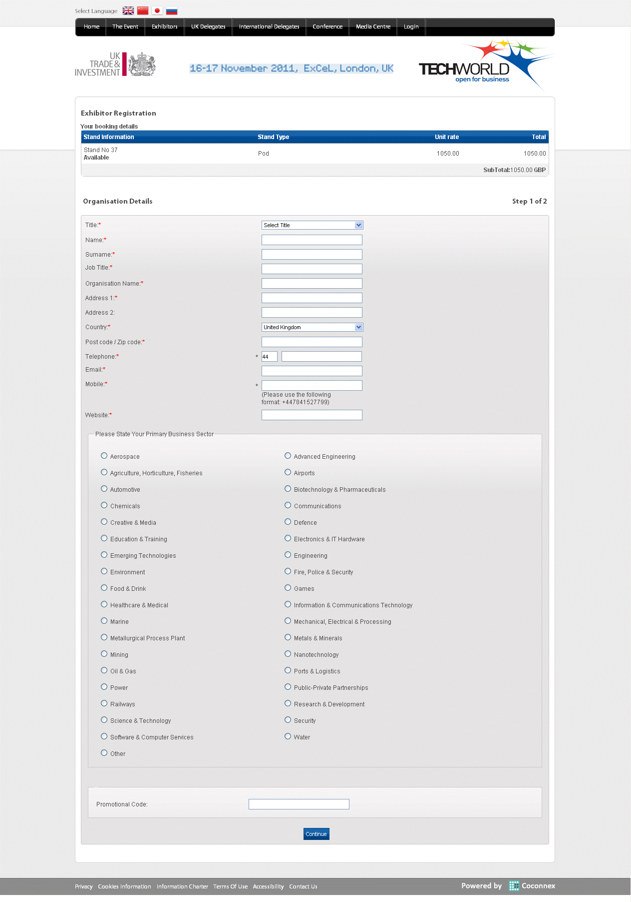
Registration – Exhibitor

Slide 13
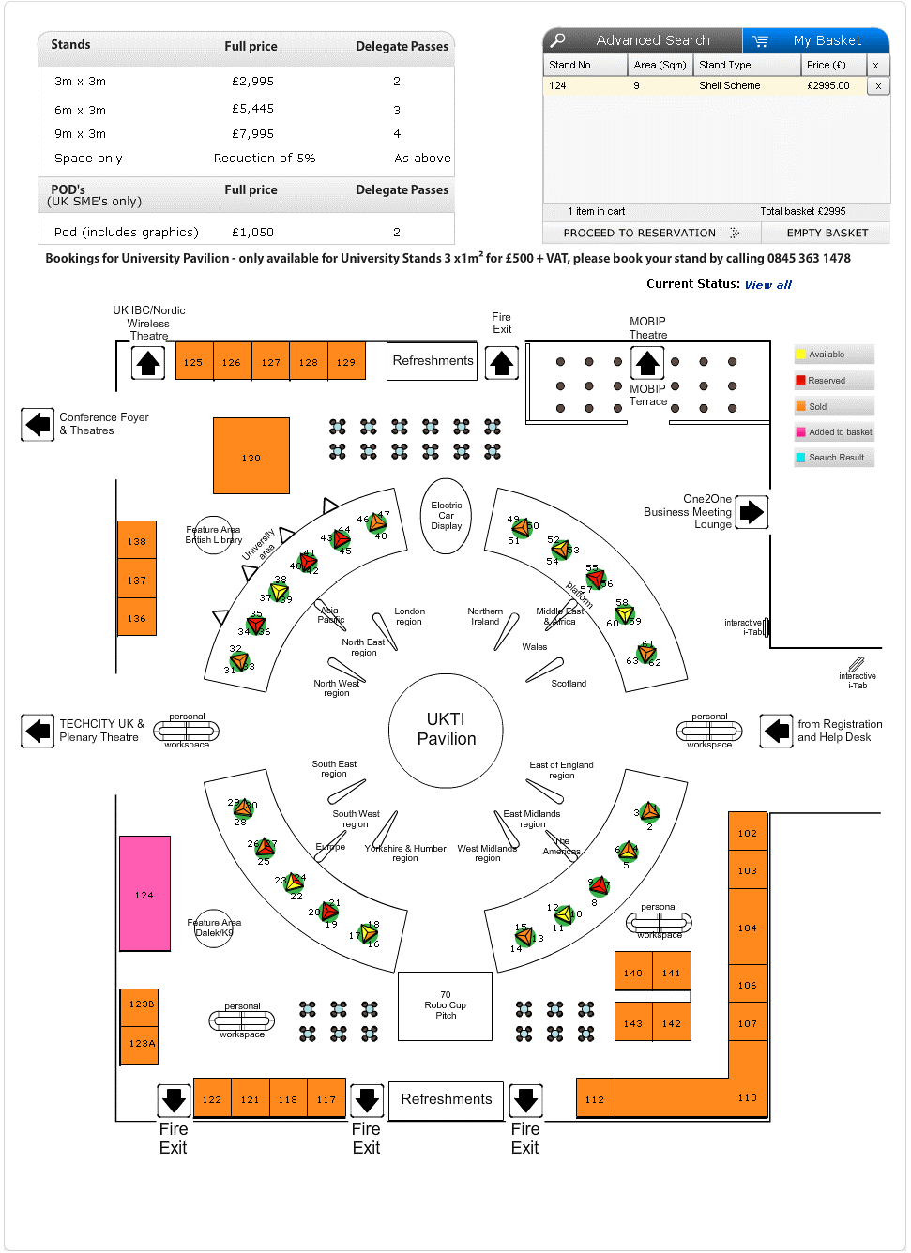
Sales View

Slide 14
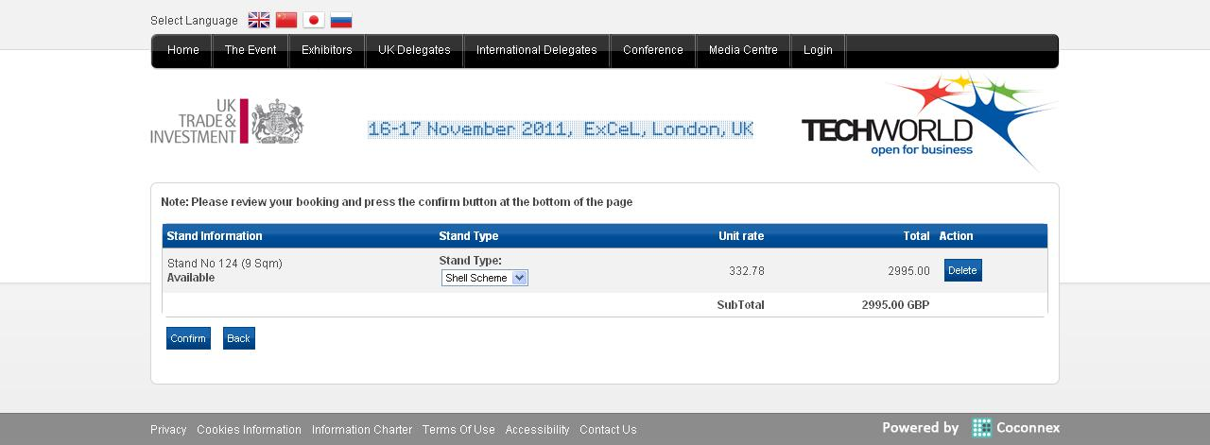
Stand Booking Details

Slide 15
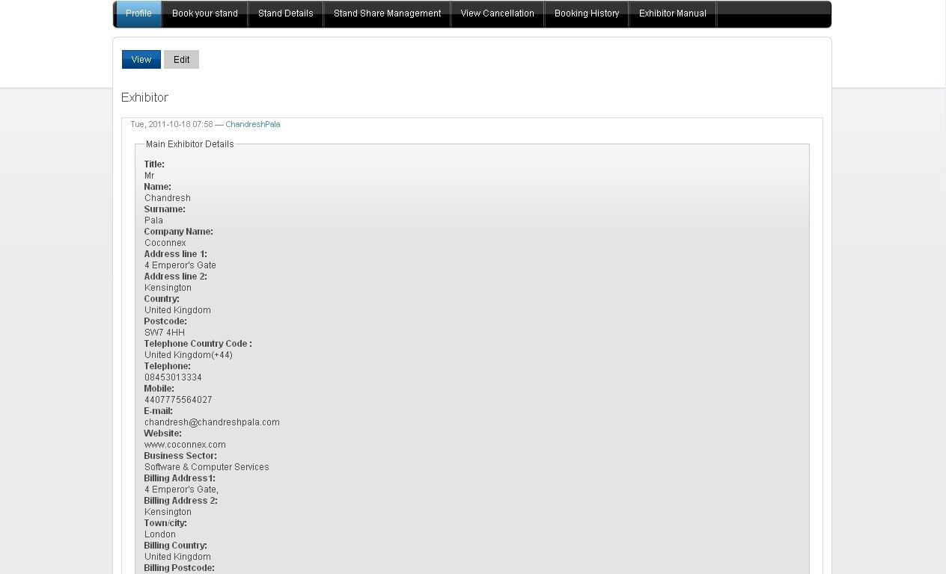
Exhibitor – Profile

Slide 16
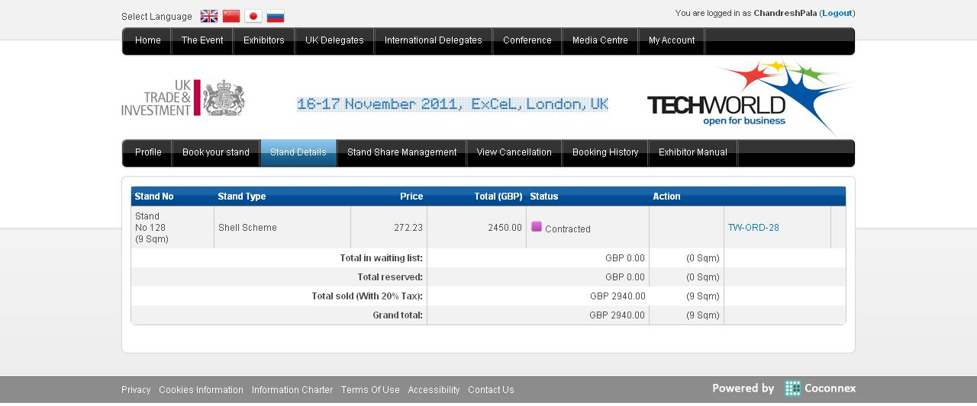
Exhibitor – Stand Details

Slide 17
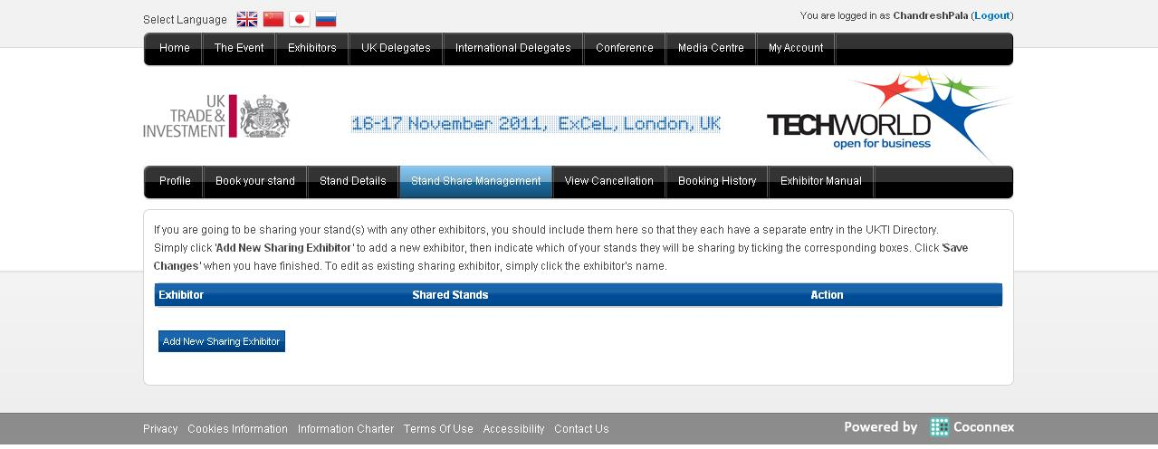
Exhibitor – Stand Sharing

Slide 18
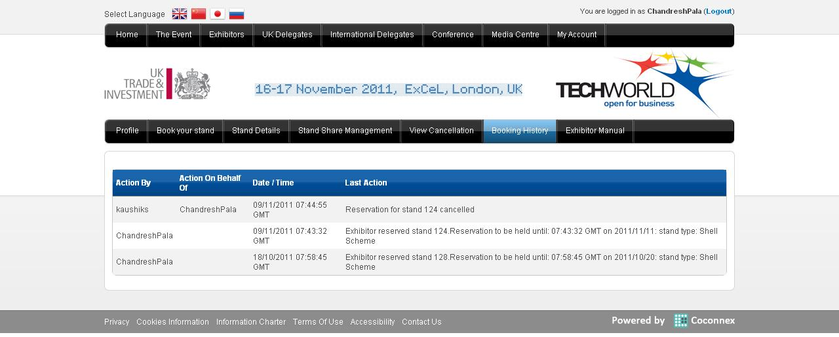
Exhibitor – Booking History

Slide 19
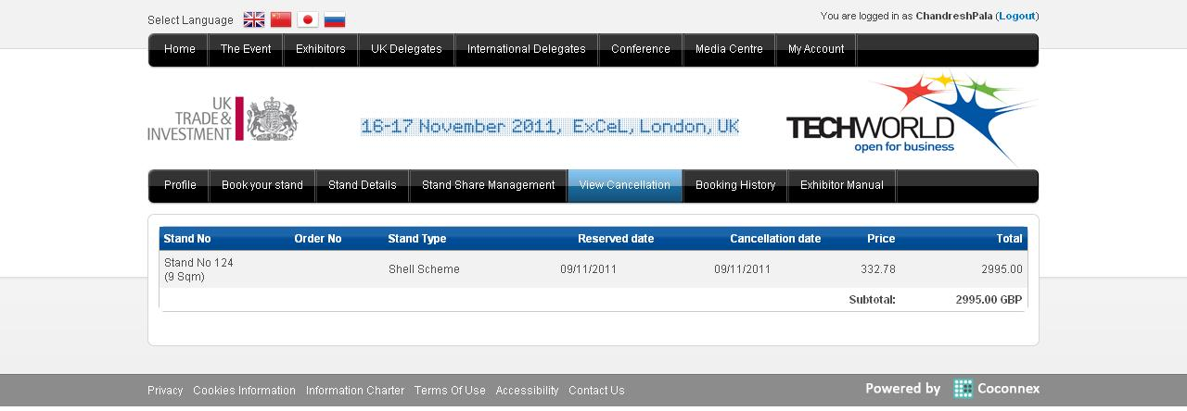
Exhibitor – Cancellation

